Slide 1


Marriott International
Engage Co-create & Automate

Slide 2
Agenda
Introduction
Enterprise Automation
IBM Automation Solutions: Safe and Secured way of doing Business
Automation Deep Dive Analysis: PMS L1 Helpdesk
Q&A
2

Slide 3






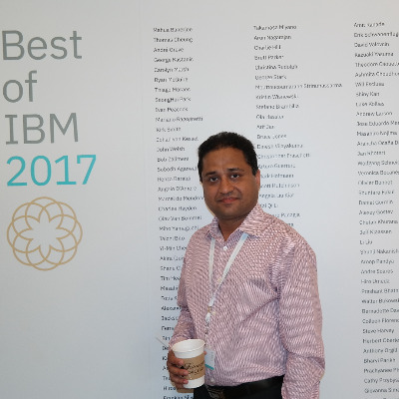







Participants
Marriott
SS
LB
DJ
Manish Gulati
Sr Dir, IT Del
Sterling Jones
Sr Dir, IT Del
Harold Sutton
Sr Solution Architect
Bharat Parekh
Dir, Prog Mgnt
Sentil Selliah
Dir, Security
Lisa Branner
Sr Mgr, Security
Davis Josh
Sr Business System Analyst
IBM
Sanjiv Gupta
Distribution Sector Leader
Akila Vasudevan
Automation Leader
Subodh Agarwal
Project Executive
Sujit Pati
Automation
Account Leader
Harish Verma
Chief Architect RPA
Soumya Basu
Sr IT Architect
Viraj Shah
Automation
Shantanu Sinha
Sr It Architect
Jalaluddin Kazi
Solution Architect
Om Sumanth
Offshore Automation

Slide 4
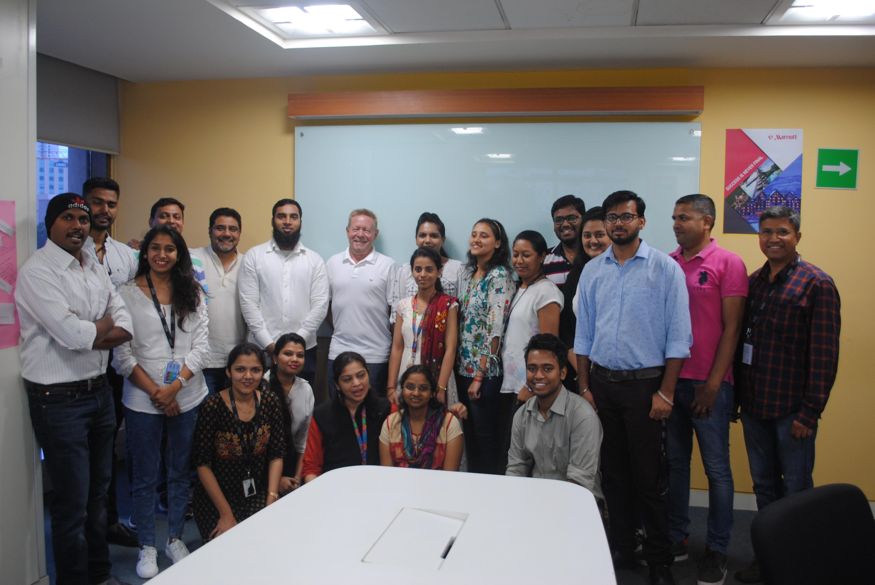
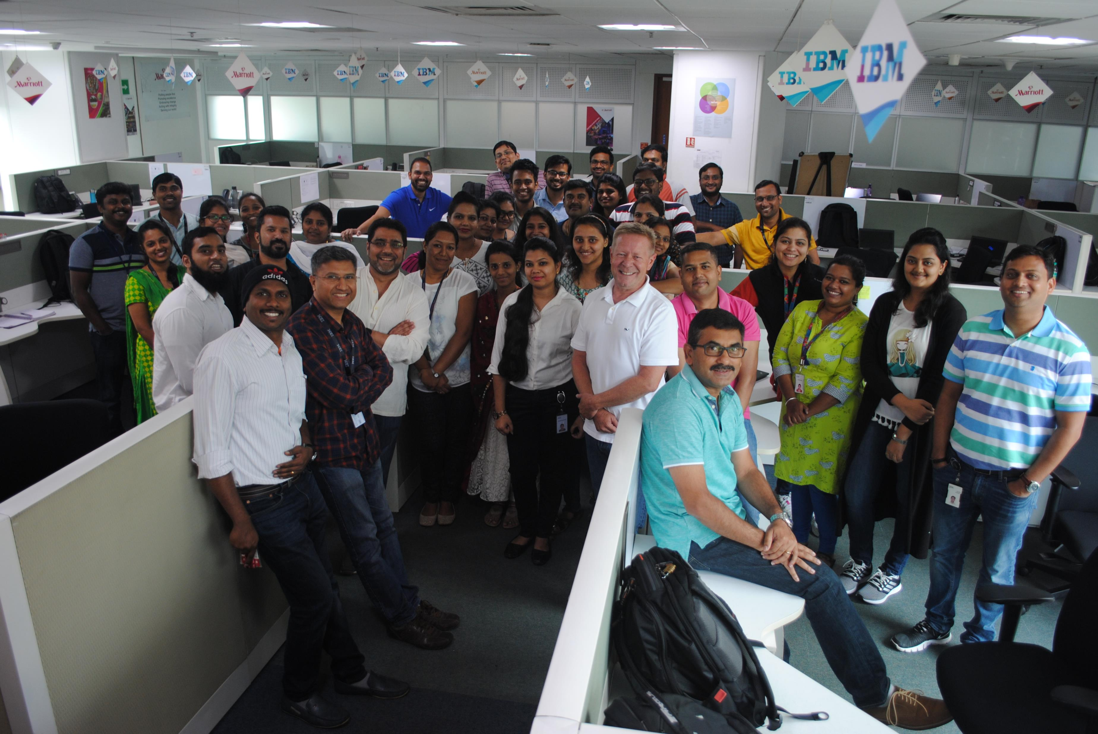

Slide 5


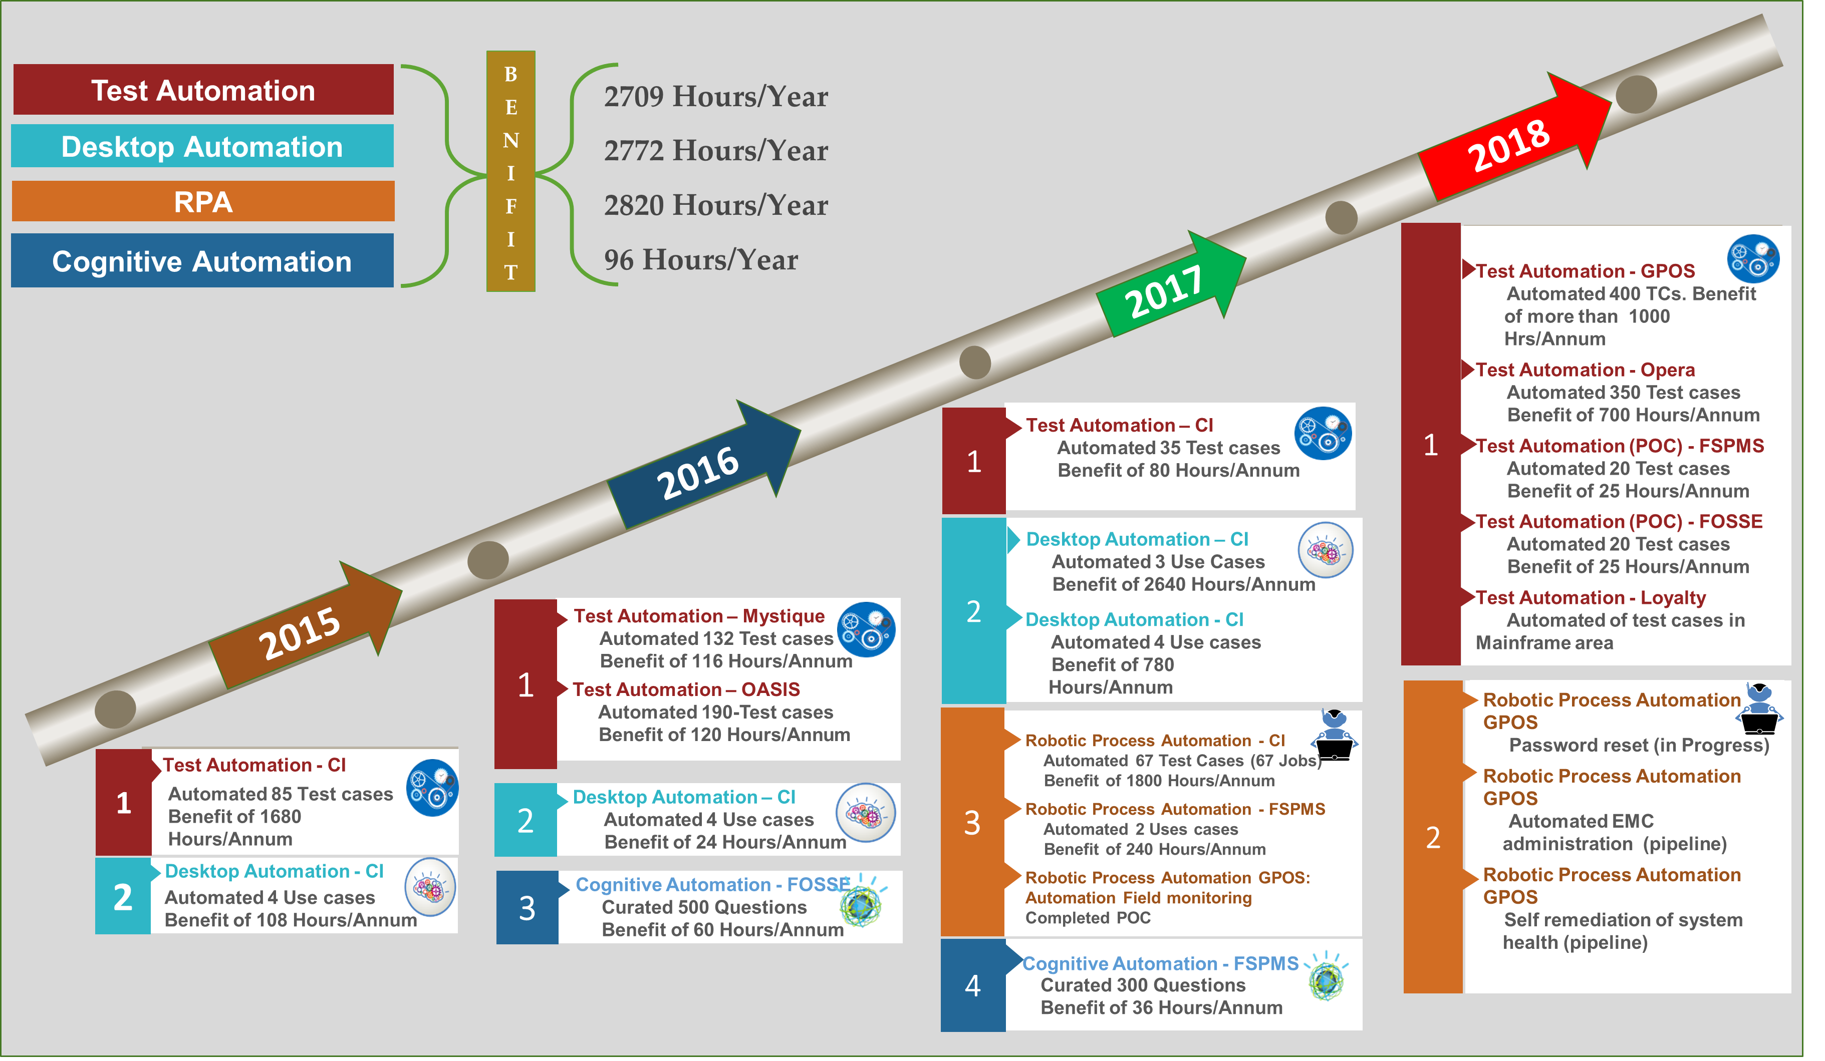
Automation @ Marriott

Slide 6



Enterprise Automation

Slide 7

Enterprise Automation – Think Big, Start Small, Expand Rapidly
Enabling the effective operation of automation
Driving the automation roadmap to results
Fully operationalizing automation at scale
Testing the “art of the possible” in automation
Building a successful automation roadmap
Cognitive Automation
Automation As a Service
Automation Business Process as a Service
Automation Application Management as a Service
Automation of Infrastructure Management as a Service
Automation Center Of Excellence (COE)
Design Automation Services Model
Establish Automation Control Center & Governance
Lead Center of Excellence
Automation Production
Agile Design & Build
IT Configuration & Infrastructure Setup
Core Integration
Automation Prototype Services
Modeling and Proof of Integration
Pilot for Business Value
Automation Strategy
Process Evaluation & Prioritization
Technical Plan & Tools Selection
Digital Workforce Plan
Benefits & Business Case
Roadmap & End State
Dynamic Automation
Powered By
Cumulative automation benefits
Test Automation
Level of automation maturity

Slide 8





DBS Bank
Unilever
Maersk
D
T
C
D
T
C
IBM helped the largest multinational bank in Southeast Asia with Enterprise Wide Process Automation
British-Dutch transnational consumer goods company. Its products include food, beverages, cleaning agents and personal care products.
Largest container ship and supply vessel operator in the world
Partnered with IBM for enterprise wide process automation
Partnered with IBM to co-create automation CoE
Partnered with IBM to transform IT Service Management
64% High cost to income ratio
Improve CSat.
Responsive to regulations
200+ Optimized Cust. Journeys
40-50% TAT faster
$4M + savings in incidents
30-40% Prod. Imp.
70 NPS
100+ Processes deployed
23+ FTE saved
54+ Systems connected
12 Robots are live across multiple applications
9 business areas touched (FICO, R&D, Cashup, P2P, APO, CLM, SCM, App Support/Monitoring, Access Control)
400+ Applications
500+ AMS Team
150+ Technologies
33% Ticket Volume
15% Resolution Time
17% Decreased AMS Run Costs
15+ New apps at no addl. cost
AmerisourceBergen
Global Retailer
nPower
C
D
D
One of the world's largest pharmaceutical distribution/services companies
IBM helped one of the world’s largest retailers to improve pharmacy operations through Cognitive Automation
One of the leading energy suppliers for UK
C
D
Partnered with IBM to automate ERP Service
Partnered with IBM to automate pharmacy helpdesk operations
Partnered with IBM to build Robotic automation to reduce IT Operation cost
100 TB of SAP instance
2000+ Custom Objects
13000+ Test Scripts
60% In-cycle time
100% SLA
40% Tickets Auto remediated
65% In interface related incidents
80% decrease in L1 Service Desk call
2 mins to resolve blocked prescriptions issue instead of hours
40% tickets resolved automatically
17 Process Automated
100% Audit Accuracy
60% Process Time Saving
Client Success Stories
Notes:
C – Cognitive Automation
D – Dynamic Automation
T – Test Automation

Slide 9
Typical Automation Use Cases
IT
Business Processes
IT Operations
Finance and Accounting
HR
Service Desk
User Administration
Password Management
Change Management
Systems Access, Routine DB, MW Tasks
Problem Management
Dispatch Automation
Incident, Problem Automation
Email to Ticket Creation
Task Scheduling in Command Center
Purchase To Pay
Invoice processing: invoice download, invoice transfer into ERP, invoice matching, PO documents processing and payment activities
AP reporting
Vendor reconciliation / inquiries
Accounts reconciliation
Work Force Administration
All Workforce Administration / EDM transactions
Payroll
Payroll inputs
Payroll calculations
Time and attendance
Record to Report
Journal processing: Automate journal posting after review and approval
Account reconciliation: automatic SAP extract and recon preparation including month-end bank recons
Reporting
Order Management & Contracting
Infrastructure Support
Backup Management
Fault Diagnosis
Patch Management
Provisioning
Service Brokerage
Printer Management
Unix and Windows Management
Middleware Management
Database Management
Service Management, Command Center, System Support
Manual Order Processing
Purchase Requisition form creation
Requisition to PO processing
PR Validation
PO Closure
Manual PO Dispatch
PO Change
Blocked Invoice Resolution
PO blocked invoice (variance on GR and Price / Qty)
Blocked invoice validation
Auto notification to vendor / requester
Catalog and Contract Administration
Catalogue upload
Contract Creation and management
Order to Cash
Order processing: Order entry, invoicing, payment posting
Cash application: payment application and receivables, download bank statements, bank account reconciliation
Data transfers between ERP systems
Monitoring and Compliance
Operation Analytics – Health Checks
Reconciliations, Performance Management
Financial Accounting (Month End) Jobs
Settlements, Reconciliations, Audit compliance activities
9

Slide 10
IBM Automation Solutions
Safe and Secured way of doing Business

Slide 11
Blue Prism High Level Architecture : Deployment Instances
Deployment Instances
Blueprism implementations for both dedicated and shared scenarios are as follows in order of IBM preference :
1. Shared Instance (IBM Cloud hosted) - Shared Blueprism instance supporting multiple customers (DEFAULT) in IBM Cloud.
2. Dedicated Instance (IBM Cloud hosted) – Dedicated Blueprism instance hosted in ‘Exclusive’ environment in IBM Cloud.
11

Slide 12

High Level Architecture: IBM Cloud
All components are deployed across IBM Cloud (Amsterdam / London) and are part of the IBM enclave which is isolated from other areas in IBM Cloud. Blueprism robots can connect to the client network or applications in two ways:
Direct Internet VPN
Site-2-Site (S2S) VPN directly to the Client Network. A site-to-site VPN is configured over the internet to securely connect the IBM secured enclave to the customer. The robots using this method are totally isolated from the Internet. The automated flow is routed into the VPN tunnel.
Via SSL VPN - The VPN connection is initiated from the robot to the customer SSL VPN. The robot runs an SSL VPN client application if required. The automated flow is then encapsulated into the SSL VPN Connection. The firewall in the IBM secured enclave prohibits any flow between the robot and other customers or the Internet.
Application
Server
Database
Server
Robots
Interactive
Client
Client Location
Robots
Internet
Robots
Client 1
Application
Firewall
Firewall
Client 2
Application
Client 3
Application
IBM Cloud (Amsterdam
& London Sites)
12
12

Slide 13
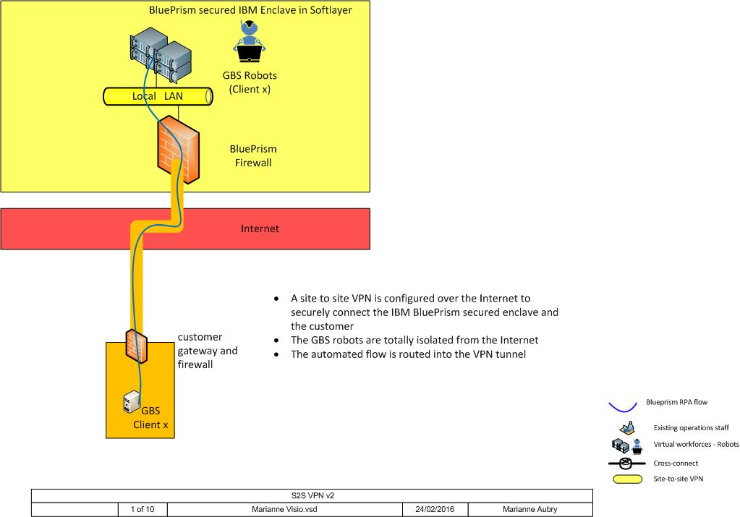
High Level Architecture: S2S Internet VPN
13
13

Slide 14
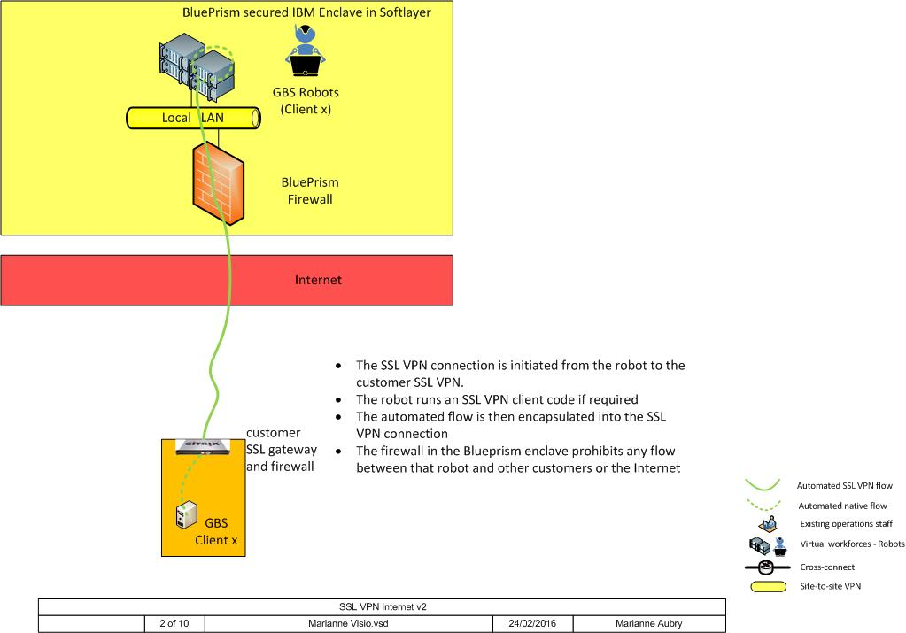
High Level Architecture: SSL Internet VPN
14
14

Slide 15
Blueprism Security / Permissions Management
User Management
Fully customisable, role based access using the principle of Least Privilege
Defined separately within the context of each environment
Governed centrally by means of integration with MS Active Directory
Three Dimensional Permissions Control
Individually controlled environments – Dev / Test / Prod
Groups of Users – Developer / Test Manager / Blueprism Administrator / Process Operator / Process Manager
Permissions - Create / Edit / Delete Processes / Run / Monitor Processes / Read Process Logs / Amend system – archiving, user control, database maintenance / Import / Export configuration
Change Management and Version Control
Process History performs as an audit feature and to facilitate rollback to old versions and in order to facilitate the correct interpretation of historic log files against the corresponding process, as it appeared at the time.
Audit and Logging
Detailed history of activity is captured by runtime robots on a case by case basis, who record every keystroke and click of their activity in a session log.
Where sensitive data (HIPAA / PCI) is concerned, the logged information can be masked or omitted.
Detail of the log relates directly back to the structure of the process diagram, making it easy to interpret for business users.
15

Slide 16

Automation Deep Dive analysis
L1 Incidents
(01-Apr-18 to 30-Jun-18)
3 months

Slide 17
Executive Summary
Marriott Level 1 Support Incidents considered for the scope of Analysis ( Client Scope )
Duration considered for the tickets is 3 months. Total tickets were 42803
Total tickets considered for analysis is 14268 per month
Number of repetitive tickets found are 3380. Considered a candidate for automation using COG solution as well as RPA solution
Out of 14268 ( per month) tickets, 2328 tickets can be automated . This is 16 %
Total use cases to be developed is 10
We found repetitive “HOW-TO” questions on reports, reservations , posting etc.

Slide 18

Level1 support: Repetitive requests can be handled through cognitive solution. Majority are similar in nature.
Analysis
Conversation Points
Use case group – | Total Monthly tickets # | % Tickets automatable | Automatable Tickets # (Monthly) | No of proposed Automatas # | Proposed solution
Level 1 requests
UC1_Password Reset | 315 | 60% | 189 | 4 | Cog+RPA
UC2_How to Post / Posting correction | 625 | 60% | 375 | NA | Cog
UC3_Computer Support | 979 | 60% | 587 | NA | Cog
UC4_Secure CRT Issues | 361 | 60% | 217 | NA | Cog
UC5_Reservation Issues | 349 | 60% | 209 | 2 | Cog+RPA
UC6_Report Generation | 320 | 60% | 192 | 4 | Cog+RPA
UC7_How to cash batch | 374 | 60% | 224 | NA | Cog
UC8_Banquet Check Balancing OOB | 365 | 60% | 219 | NA | Cog
UC9_FSPMS VIPER server | 192 | 60% | 115 | NA | Cog
Total | 3880 |  | 2328
The L1 tickets are mostly can be resolved by implementing the Cog solution.
The Helpdesk overall percentage of L1 ticket will potentially go down over a period of time as the Cog curation will increase.
The Cognitive solution will help in providing the required information and will invoke RPA for password reset , report generation and reservation issues.
Summary
~ Monthly 3880 tickets will be handled through cognitive solution.

Slide 19
Q&A

Slide 20
Blueprism Frequently Asked Questions
Q. Why does the Robot require a Generic ID?
A. The robot needs to have the same privileges as the humans performing the task today and it is not necessary to provide a non-expiring password. Password changes can be managed proactively (building the password change into the code) or reactively (enabling the robot to recognise expired password and change it).
Q. How are the actions of the robot secured and performed in a governed environment?
A. There is a role based access and development approach, where control points are applied to ensure that only an automation that has been developed according to the initial process brief is allowed into production. Access to the production robots is restricted to the process manager role, who effectively is the "owner" of the virtual resources and interface with the existing manual process owner.
Q. Is the Database Server in IBM Cloud accessible to other accounts?
A. The database server is shared and in some cases, the database itself. However access to the database is only given to the application interfaces and sysadmins.
Q. How is the Audit log segregated in the shared solution where other accounts are also supported? A. A custom report will need to be created to segregate the audit logs for a specific client (if required).
Q. What information would be stored in the Audit logs on the cloud? Will it cause any data breach or raise concerns on data privacy? What other information will be stored on Cloud?
A. Only information that is used by the process. For example, if the team store a ticket number as a variable, then this will be in the database for use by the process.
Q. As the robots reside outside of the client environment how does IBM how ensure no changes are made without client knowledge?
A. Please see the Blueprism Audit/Logging slide for more information but there is an audit trail available on Robots and all changes will first be verified/tested in the ‘Test’ environment and will then be approved by the client before migration to ‘Production’.
20
FAQ’s
20

Slide 21
Blueprism Frequently Asked Questions (…cont)
Q. What encryption standard is currently used for the credential management in the password vault on the shared database server?
A. Currently it is AES256. We can also apply another layer of security if required whereby the AD credential used to log into the robot is
client specific, such that any work done in a client can only be performed under that particular credential.
Q. How are the robots themselves securely managed?
A. Access to production robots is secured by an additional layer of security provided by the ‘Hypervisor’. This means that you are only permitted to view the console of a robot if you are a process manager who has responsibility for that process, which is mapped to AD role.
Q. What Anti-virus software is installed in Blueprism? A. Symantec Endpoint Protection is deployed on all Blueprism systems.
Q. Are the Blueprism processes retested with new versions of client software that it is automating against?
A. Yes this would need to be tested by the IBM developers once they have been informed of any changes to the client systems involved in the process.
Q. Can a single Blueprism robot be shared with multiple clients?
A. Yes, a single robot can be shared. To ensure this process stays secure separate windows domain credentials are used to log on to the robot (to service separate clients).
Q. Is there any downtime/operational maintenance activities for Blueprism on Cloud?
There is maintenance and it is currently covered in the 95% availability Service Level Objective (SLO). This becomes 98% if you take out maintenance.
Q. How much resource will be used by the robot(s) ?
A. As a minimum this would be the same as any AMS consultant logging in. In fact it will be a little faster/quicker.
21
FAQ’s
21

Slide 22
Blueprism Frequently Asked Questions (…cont)
Q. What Anti Virus is to be used for Security Scanning?
A. Use of Antivirus (Trend Micro) and SIEM scanning (QRadar) will be implemented into the Service Provider environment.
Q. Can a Robot use existing Socks server connectivity via One Network?
A. Whilst it is technically possible because of IBM security/strategical reasons the answer is No. The socks server only permits connections originating from the IBM gSNI/9. network (internal network) for security reasons.
Q. When using a VPN client, connectivity can be established to the customer network, but the VPN connection blocks all inward traffic to the originating machine.
A. This is not a problem caused by the location of the environment. If we had this deployed on IBM Blue the problem would still exist, because the BP robot needs to talk to the application server. Blueprism is a client / server application, so using internet VPN clients that block these communications are not going to work.
There are only 2 solutions :
Establish a proper connection with the client environment from Blueprism, via S2S VPN as we are doing with most clients
Find a way of configuring the client VPN to allow the necessary ports back to Blueprism. I am not sure if this is even possible with the client you are using so you would need to investigate with the vendor or in the product manuals. Some have ability to configure the local firewall for the client, but in general this is set by policy from the server side, so would be enforced by the customer's policy.
Q. Does the robot work in a sequential mode only?
A. Each robot works as a single threaded action. If additional monitoring by events is needed then the configuration of multiple Robots will be needed based upon the requirement.
22
FAQ’s
22

Slide 23
Robotic Process Automation Security Principles
A robot running on a virtual desktop in an RPA context will be emulating a human interaction with a target application and will behave in a very similar way, therefore much of the security considerations will be aligned – the access method, encryption and credential management controls applied will similar or identical for the Robot as it would be for a human. Physical and logical security controls will be applied in order to protect the access to the environment and active Robots. The following core principles will be adhered to in all deployment models.
Operating System Compliance and Security Standards
The RPA environment runs both Server and Desktop based Operating Systems, however both environments are treated primarily under governance by IBM ITCS104 standards. The desktop client Technical Specifications will be created to closely match that of the Windows Server OS, but will also apply additional appropriate controls from ITCS300 and Microsoft’s security recommendations for the platform.
Cloud Security Governance
Any new environment deployed on SoftLayer must be compliant with the IBM ITCS Cloud Security Policy. IBM’s Cloud Security team performs a formal assessment and any changes are logged in this profile and assessed periodically.
Runtime Resource PCs (Robots) – Network Placement and Access
In this current design, placement of Runtime Resources (Robots) outside of the Service Provider instance is only possible if there is the ability to create a trust to a local domain from the Service Provider domain. This is because secure .NET remoting is only possible when application server and robot are within a domain. A future release of Blueprism will remove this restriction, allowing for a more distributed model.
Hypervisor Access Security Considerations
Blueprism recommend the use of a virtualised platform for deployment of runtime Resources and Interactive Clients, as this offers the best security protection. However, it is also important to consider the security of the Hypervisor, as administrative level access to the Hypervisor allows someone to view sensitive information via the console. The following guidance will be followed to restrict this level of access. These are applicable to an ESXi Hypervisor, but equivalent controls must be implemented, in the instance where an alternative Hypervisor is used.
Runtime Resource PCs and Interactive Clients will be placed in a separate folder in Vcenter, with the “View Console” right tightly controlled, according to the need for users who will use Vsphere for remoting of Runtime Resources (Robots).
Access control of the above must be linked with Single Sign On and will be controlled via Active Directory groups, linked to the Role Based Access Model.
23

Slide 24
Robotic Process Automation Security Principles (..cont)
User Authentication and Single Sign On
Use of Single Sign On is mandatory in all deployments, for Infrastructure and Application access control. Application authentication will be controlled by mapping of roles within the Blueprism environment, linked to Active Directory Security Groups.
Active Directory Integration
Use of secure .NET remoting requires the integration of the Application Server, Runtime Resources (Robots) and Interactive clients into an AD domain. In the Service Provider deployment models, a dedicated Active Directory environment has been implemented and this will be used to control all access within the environment via Single Sign on (SSO). In a dedicated instance, integration of the Blueprism environment to the local Active Directory domain is necessary. Integration with Active Directory is mandatory in all deployment models.
Segregation of Components
To ensure the security of Client systems, the following principles of segregation will be adhered to :
The Blueprism Database can be shared between clients, as long as the same support resources support all accounts being managed on the instance.
Application Servers (VMs) can be shared. Additional instances of an application server can be started on the same server, assuming appropriate system resources are available. Dev and UAT application server instances may be collocated on the same VM. Production instances will be on a separate VM to Dev and UAT.
Runtime Resources may be shared between accounts within the same Blueprism instance. A client specific domain account will be used for the robot when logging in to execute automation, in conjunction with the Blueprism Login Agent. This will provide separation between workloads performed on the same Virtual Machine.
The Interactive Client for Monitoring and control will be hosted directly from the RDS environment as a published application. Separate instances of Blueprism can be accessed this way by means of different connection profiles.
Dedicated Interactive Development Client VMs will be required for each instance of Blueprism to serve the needs of the assigned IBM development team. Developers within the same team may share these.
Network Micro-Segmentation (Only applicable with NSX)
In the global hub and any other that is deployed alongside VMware NSX additional Micro-segmentation of components and Blueprism instances will be implemented. By default, this will establish firewall segregation between each Instance, and between the Database, Application and Client layer. Any Web facing components will be segregated from the rest of the environment.
24

Slide 25
Robotic Process Automation Security Principles (..cont)
Separation of Duty (SoD) Model
The protection of Client systems from unauthorized actions executed by a privileged system within the RPA environment must be assured not just by means of technical restrictions and controls, but by process and by careful consideration to the Separation of Duties between Development, QA / Testing, Deployment and Maintenance of an Automation or Robot. A full Separation of Duty model is in place and underpinned by the Role Based Access Controls (RBAC), such that there is clear distinction between the stages of development, testing and deployment.
Credential Management and Security
The security of the credentials used by the teams involved in management and development of RPA and the Robots themselves is paramount in protecting the security of the environment. The following guidance can be applied in all deployment models :
Role Based Access Control
Both the access to the systems and the application will be protected by a Role Based Access Control structure (RBAC), which is tightly interlocked with the Single Sign On and Active Directory domain group structure. This will complement the implementation of the Separation of Duty model, whereby no one person will have the rights to develop, test, deploy and monitor a Robot.
Blueprism Secure Credential Manager
The Blueprism application includes a credential manager, which provides an encrypted store for any credentials used by a process. This is encrypted using AES256 bit. Existing standards for credentials will be followed (expiry, password complexity, etc.) based on IBM’s ITCS104 standard, or the client standard – whichever is strongest.
Robot Domain Credentials and Login Agent
The Blueprism robots run as a local domain user (instrumenting applications on the desktop, which may have their own credentials). To enhance the security of the environment, the Blueprism Login Agent will be used. This is a Windows Service that starts on boot of the OS. On execution of automation, a login process is executed to log in the robot into the desktop. These credentials are “checked out” of the credential store by the robot, such that no human intervention is required. The credentials may be defined per environment, or per client, or even per robot, depending on the deployment model and approach. As a minimum, the recommendation is for one user per environment, per environment (i.e., separate credentials for Dev, UAT and Prod) and to use separate credentials per Client, if robots will be shared between clients.
25

Slide 26
Robotic Process Automation Security Principles (..cont)
Application Credentials
The credentials used by a robot to log into an application will be provisioned and managed according to the application or client specific case. In other words, if the application requires a 30-day password expiry, then this must be factored into the design of the automation. Under no circumstances will the credentials of a person be used within automation; they will be provisioned specifically for the Robot. All credentials must be stored in the local Blueprism Credential store and checked out by the process. In the case that the client, or a local credential store does not allow this, then the Robotic process can be programmed to interact with an external store, such as CyberArk, assuming it has the network access to do so.
Activity Auditing
Activity auditing is an important feature of the Robotic Process Automation security architecture. All changes within the platform, including changes to the RPA infrastructure, automations run and activities performed by the RPA infrastructure are captured and logged :
Platform Audit:
Changes to the platform itself are audited as well as changes within it. Each event, as well as each change, is audited.
Events, including actions such as merely logging in to the system; for example. Changes include interventions such as amending environment variables; making changes to users' privileges; the importing and exporting of data; etc.
Application components will generate logs of all user and privileged activities, including:
Logon and logoff actions
Failed logons
Privileged actions taken, both successful and unsuccessful
Operational Audit:
Work items are typically captured in a Blueprism queue. This provides Operations teams with immediate access to case status and outcomes as well as management information on case times, creation & completion dates, etc.
A detailed history of activity is captured by runtime robots on a case-by-case basis, who record all of their activity in a session log. This record includes - for example - every button pressed, every piece of data that is read, every decision made, etc.
Where sensitive data is concerned, the logged information can be masked or omitted if necessary in order to comply with data standards such as PCI. The detail of the log relates directly back to the structure of the process diagram, making it easy to interpret for business users.
26

Slide 27

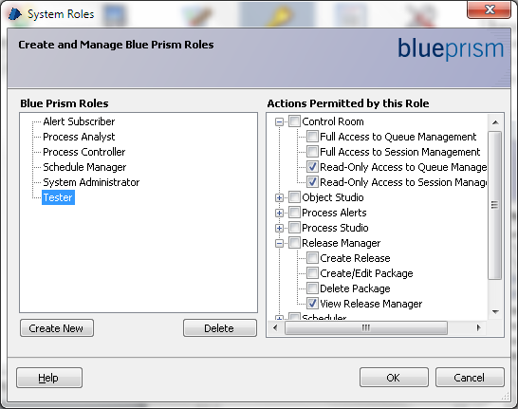
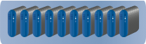
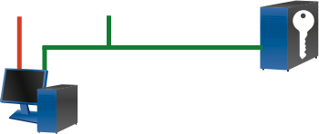

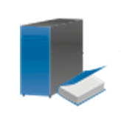
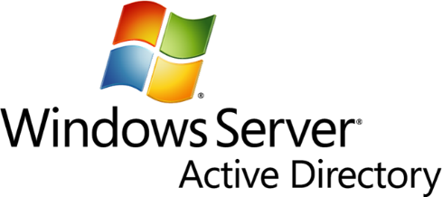
Robotic Process Automation Security Principles (..cont)
Blueprism User Permissions / Access Control
User Management
Active Directory Integration
Virtualised Resource PCs
Application Server
Database
Blueprism Client
Authentication and
permissions - LDAP
Active Directory Controller
(authentication)
Fully customisable role-based access is available, using the Principle of Least Privilege. Individual users and whole groups of users can be assigned administrator-configurable combinations of system access rights.
This access is defined separately within the context of each environment: Development, UAT and Production so that, for example, wholesale editing rights need not be granted across the board but instead in strict isolation.
User Access will be governed centrally by means of integration with Microsoft Active Directory. This allows system access to be maintained under the central control and governance of an authorised administrator, in the context of users’ other access rights across the network.
27

Slide 28
MoM

Slide 29
Takeaway from Road Show
Subodh introduced the Automation journey in Marriott so far.
Akila provided the overall view of Enterprise Automation and it's importance in today's business.
Discussed the various connectivity method between robot and the client network. Site to Site (S2S) vs through SSL Marriott agreed for the existing S2S connectivity.
Good discussion happened around getting robot access to SaaS applications vs application on Marriott network that need domain authentication.
Follow up call to be set up with Marriott security (Senthil and his team) to discuss the right way of providing domain access to a robot, building upon the existing process of getting a service or application account.
IBM emphasized that all of their RPA platform layers are GDPR complaint.
IBM shared the result of the 3 months FSPMS L1 helpdesk ticket analysis :
16% tickets (around 3000 out of 14000 tickets) are repetitive in nature and can be automated. There are total 10 use cases, a combination on Cognitive and RPA solutions.
Session to be set up with Sterling to discuss more details and the next step forward.
5 Automation opportunities (combination of RPA and Cognitive) worth of more than $1M TCV were identified during the discussion.
POS FOSSE F&B ftp automation: $330K (Q4’18)
POS Data dashboard: $170K (Q4’18)
FSPMS L1 helpdesk automation: $150K (Q1’19)
POS Workstation Reimage: $300 K (Q1’19)
Opera Test automation: $150K (Q1’19)

